Slide 1
The BLE-Enabled Sensor Cruncher
UCSC-SVE: Embedded Firmware Essentials
Dave Blevins
Zihui Wang
Wayne Fang
Sudheendra Sampath
December 2014

Slide 2
Concept
Implement bi-directional communications between a sensor-equipped mbed board and an iPhone, using the Bluetooth Low Energy protocol
Sensors are
  Flex sensor, whose resistance varies as the strip is bent back and forth
  Contactless temperature sensor
Going in the other direction:
  Four slider switches in the Iphone app control the mbed LEDs
  a slider control in the iPhone app controls the value shown on the LED hexadecimal displays connected to mbed

Slide 3

Demonstration Video
http://youtu.be/A26xRH9IU_o

Slide 4
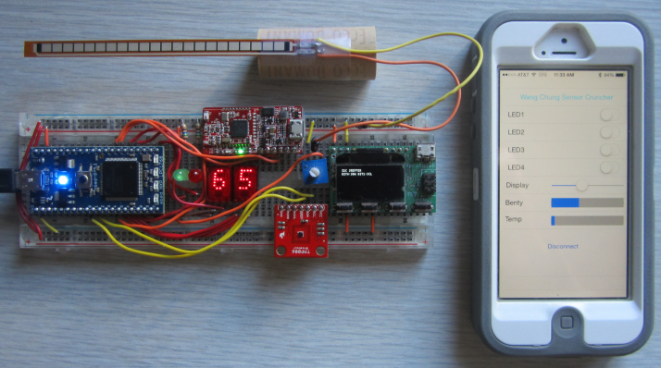
Hardware
Flex Sensor
SensorCruncher code running on iPhone
Red Bear Labs
BLE board
HP Hexadecimal
Displays
Min/Max
LEDs
Xprotolab Oscilloscope/
Protocol Sniffer
(for debug)
Temperature
Sensor

Slide 5
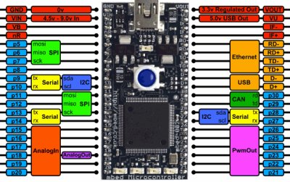
Block Diagram
p9 – p10
I2C Temp
Sensor
p27 – p28
BLE UART
p13 – p16
HP LSD
Limit LEDs
p18 – p21
p25 – p26
HP MSD

Slide 6
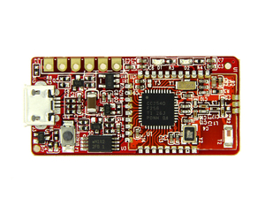
Red Bear Labs MiniBLE
Bluetooth Low Energy board
Simple UART TX/RX interface
Defaults to 57,600 baud
Can be flashed with various firmwares for different functionality
Uses TI CC2540 Bluetooth SoC
Serial bluetooth( p28, p27 );
bluetooth.baud( 57600 );
char charCent, buf;
Int cent;
sprintf( charCent, "T%.ft", cent );
bluetooth.puts( charCent );
if( bluetooth.readable() )
buf=bluetooth.getc();

Slide 7
Bluetooth Low Energy
Not mentioned in textbook
Not backward-compatible with “Classic Bluetooth”
Part of Bluetooth 4.0 spec; devices can implement BLE and/or Classic
Pairing not required
Not voice-capable
Bit rate = 1Mbit/sec
Max current draw is about ½ that of Classic

Slide 8
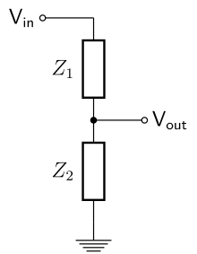
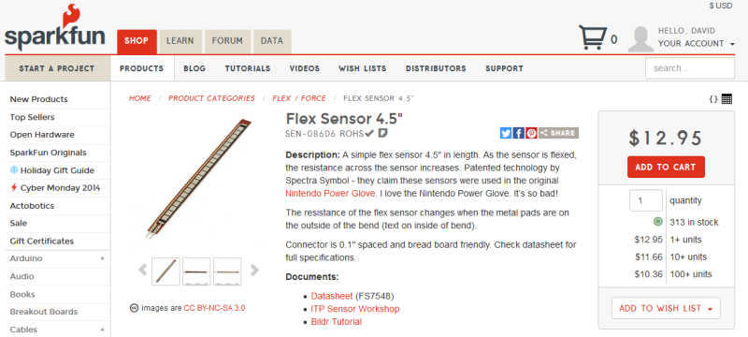
Flex Sensor
Simple, 2 pin variable resistor
Part of a voltage divider whose output is connected to an mbed analog input pin
Flex sensor
AnalogIn bendy(p20);
flexValue = bendy;
To mbed pin 20
10K potentiometer

Slide 9
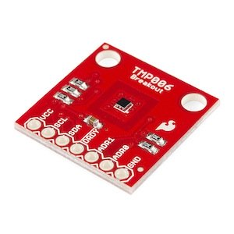
Contactless Temperature Sensor
Sparkfun TMP006
-40°C ➔ +125°C range
Employs a “Thermopile”
I2C interface
#define Address 0x80
TMP006 sensor( p9, p10, Address );
cent = sensor.readObjTempC( Address );

Slide 10
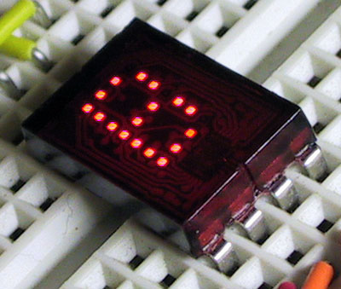
HP Displays
1999-vintage 5x7 pixel hex displays
Built-in hex converter chip
4 pins ➔ 16 possible display values
5V logic

Slide 11
HP Display Code
DigitalOut one28(p21), sixty4(p19),
thirty2(p18), sixteen(p17);
DigitalOut eight(p16), four(p15),
two(p14), one(p13);
buf = bluetooth.getc();
one28 = (int)buf & 128;
sixty4 = (int)buf & 64;
thirty2 = (int)buf & 32;
sixteen = (int)buf & 16;
eight = (int)buf & 8;
four = (int)buf & 4;
two = (int)buf & 2;
one = (int)buf & 1;

Slide 12
GitHub Repositories
iPhone & mbed source code, etc:
  https://github.com/blave/e4357/tree/master/finalProject
Presentation:
  https://github.com/blave/e4357/tree/master/FinalProject%20docs

Slide 13
Complete mbed Source Code
#include "mbed.h"
#include "ble_mini.h"
#include "TMP006.h" // temp sensor support
#define Address 0x80 // temp sensor address: ADR0 = ADR1 = GND >>> address = 0x80
DigitalOut one28(p21), sixty4(p19), thirty2(p18), sixteen(p17); // BCD outputs for HP hexadecimal 5x7 pixel displays
DigitalOut eight(p16), four(p15), two(p14), one(p13);
DigitalOut myLed1(LED1), myLed2(LED2), myLed3(LED3), myLed4(LED4);
DigitalOut greenLED(p26), redLED(p25);
AnalogIn bendy( p20 ); // set pin to read flex sensor/resistor voltage divider value (sensor & resistor: 10K ohms)
TMP006 sensor( p9, p10, Address ); // assign I2C pins and I2C address that temp sensor is connected to
Serial pc( USBTX, USBRX ); // USB serial port "pins"
Serial bluetooth( p28, p27 ); // pins for BLE Mini board
int main()
{
float cent, fahr, previousTemp, newTemp;
char charHpNumberScaled[10], charCent[10]; // Character arrays to hold values so that "puts()" can be used
// to print to BLE
char buf; // Buffer for holding incoming bluetooth traffic
int hpNumberScaled; // hpNumberScaled is the flex sensor's value scaled to 00-ff
int previousFlex = 0, newFlex = 0;
bluetooth.baud( 57600 ); // Set bluetooth instance's baud rate to that of the BLE Mini board

Slide 14
while(1) // Loop forever
{
//******* Flex sensor handling *************************//
previousFlex = bendy;
hpNumberScaled = bendy * 255; // Scale flex sensor reading to the range of the 2 HP hex displays' range
sprintf( charHpNumberScaled, "F%df", hpNumberScaled ); // Convert flex sensor values to strings for "puts()"
// and pad strings with characters that identify what they contain
bluetooth.puts( charHpNumberScaled ); // Print to BLE Mini
//******* Temperature sensor handling ******************//
previousTemp = cent;
cent = sensor.readObjTempC( Address ); // Read IR temp sensor's value
sprintf( charCent, "T%.ft", cent );
bluetooth.puts( charCent ); // Write to BLE UART
newTemp = cent;
newFlex = bendy;
if( newFlex < previousFlex || newFlex > previousFlex || // Only print to USB console if
( newTemp < previousTemp || newTemp > previousTemp ) ) // temperature and/or flex sensor value
// has changed since last loop
{
pc.printf( "Temperature: %.fC / %.fF Flex Sensor = %d / 0x%x\r \n",
cent, fahr = (cent * 1.8) + 32, hpNumberScaled, hpNumberScaled);
}

Slide 15
//******* Read data transmitted from iDevice to control the 4 on-board mbed LEDs
// and HP hexadecimal displays ********//
if( bluetooth.readable() )
{
buf=bluetooth.getc();
if(buf==ON_INTERNEL_LED1) myLed1=1;
if(buf==OFF_INTERNEL_LED1)myLed1=0;
if(buf==ON_INTERNEL_LED2)myLed2=1;
if(buf==OFF_INTERNEL_LED2)myLed2=0;
if(buf==ON_INTERNEL_LED3)myLed3=1;
if(buf==OFF_INTERNEL_LED3)myLed3=0;
if(buf==ON_INTERNEL_LED4)myLed4=1;
if(buf==OFF_INTERNEL_LED4)myLed4=0;

Slide 16
if(buf==0x14)
{
buf = bluetooth.getc();
one28 = (int)buf & 128; // send BCD-encoded value of iDevice "Display" slider to the 2 HP displays
sixty4 = (int)buf & 64;
thirty2 = (int)buf & 32;
sixteen = (int)buf & 16;
eight = (int)buf & 8;
four = (int)buf & 4;
two = (int)buf & 2;
one = (int)buf & 1;
if( (int)buf < 32 ) // Light green or red LEDs if the iDevice slider is all the way to the left or right
{
greenLED = 1;
}
else if( (int)buf > 220 )
{
redLED = 1;
}
else
{
greenLED = 0;
redLED = 0;
} // end red/green LED conditionals
} // end of if(buf==0x14)
} // end of if(bluetooth.readable())
wait(0.05);
}
} // end of main()

Slide 17
ble_mini.h
#ifndef _BLE_MINI_H
#define _BLE_MINI_H
#endif
#include "mbed.h"
//Command List
//valid port:1,2,3,4
#define ON_INTERNEL_LED1 0x01
#define OFF_INTERNEL_LED1 0x02
#define ON_INTERNEL_LED2 0x03
#define OFF_INTERNEL_LED2 0x04
#define ON_INTERNEL_LED3 0x05
#define OFF_INTERNEL_LED3 0x06
#define ON_INTERNEL_LED4 0x07
#define OFF_INTERNEL_LED4 0x08

